Slide 1


Clustering Image Search Results by Entity Disambiguation
Kaiqi Zhao, Zhiyuan Cai, Qingyu Sui, Enxun Wei, and Kenny Q. Zhu
Shanghai Jiao Tong University

Slide 2
Outline
Motivation of image search result clustering
Existing image clustering techniques
Tri-Stage Clustering (TSC) framework
Evaluation

Slide 3
Motivation of Image Search Result Clustering
Notes:
From 0 min

Slide 4
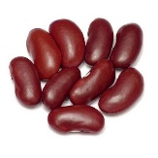

Image Search Result
Notes:
John needs to search for images of beans to prepare his presentation. He input the query term bean and Google returns him the results as a mixture of several entities related to bean, including 5 related persons and the bean he wants to search. He feels difficult to look for images of beans, to say nothing of choosing from them.

Slide 5
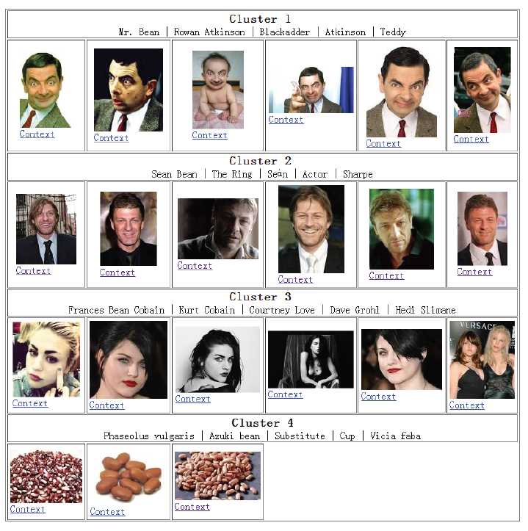
Clustered Image Search Result
Outcome:
Clusters of Entities
Representative Terms
Notes:
If the image result is clustered, John may feel it convenient to find out images for beans and know what are the other entities by checking the representative terms that used to characterize the entity. John can even look for more images about one entity if he click on one of the cluster, then the system uses those representative terms as keywords to search for images that highly related to the entity that John clicks. Therefore, we aims to provide to outcomes in our framework. One is the clusters of entities, the other is the representative terms for each entity.

Slide 6
Existing Image Clustering Techniques
Notes:
From 2 min

Slide 7
Existing Techniques
Content-based
Local visual features:
SIFT, edge histogram, etc.
Global visual features:
Color histogram, contrast, gray scale, brightness, etc.
Context-based
Bag-of-words model
Hybrid
Multi-modal constraint propagation, using modals of textual and visual graphs.

Slide 8
Problems in these techniques
Content-based: Unreliability of visual features
Context-based: Ambiguity of words/phrases in the context
Hybrid: Semantic gap between textual and visual features
We focus on context-based approach but use different features in different ways
Notes:
Explain the problem of the context-based approach using the two photos with suits and the one with like a pope.

Slide 9
Challenges
What kinds of context should we use to distinguish different entities?
How to make use of each kind of context?
Could we generate representative terms for each cluster/entity?

Slide 10
Tri-Stage Clustering Framework
Notes:
From 5 min

Slide 11
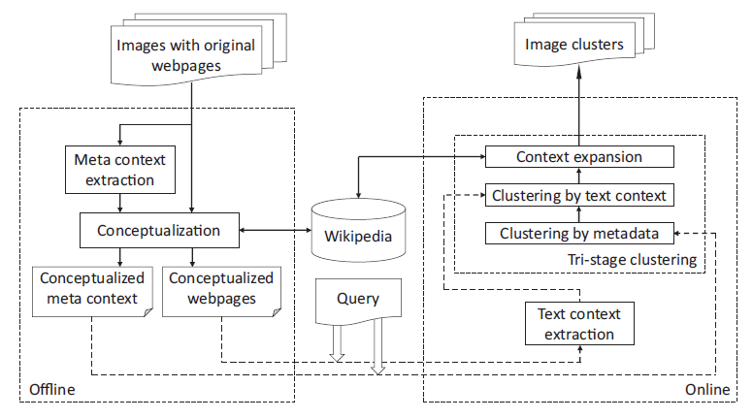
Blueprint
Notes:
Introduce two context extraction components in the red box, explain why the text context extraction is put online
Highlight conceptualization and the clustering process
Explain the online process

Slide 12
Context Extraction
Meta context
Alternative text & image title
Text in the “ALT” attribute of <IMG> tag
Text in the “Title” attribute of <IMG> tag
URL
http://domain.com/53C316-C2oJ5/mr_bean.jpg
mr bean
Split to words
Detect random strings using a two-class classifier
Notes:
From 7 min
Simply say how we extract the meta context

Slide 13
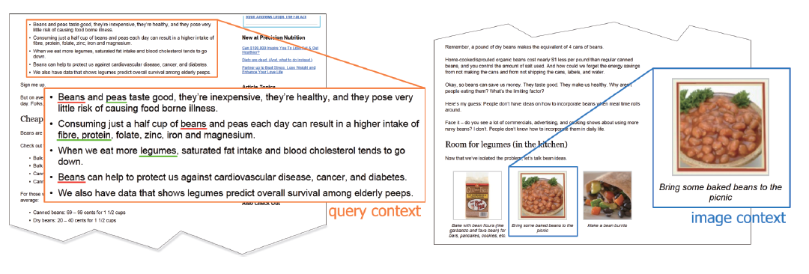
Context Extraction
Text context
Image context – text around the image
Query context – text around the query term in the page
Extract text within 100 words before and after as text context
Notes:
Show case the text context extraction

Slide 14
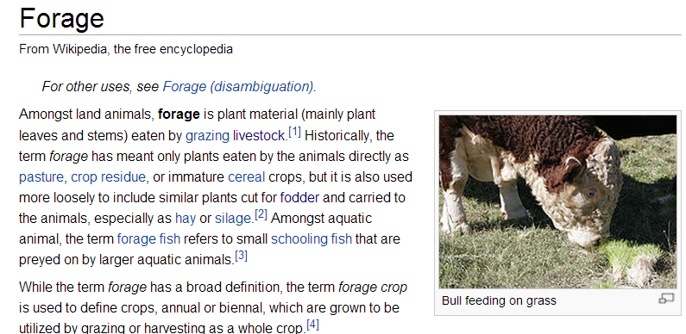
Conceptualization using Wikipedia
Plain text to Wikipedia concepts – Wikification via Co-occurrence (Cai, CIKM’13)
Bean
Bean Kent
Mr. Bean
……
Plant
Physical plant
Plant (snooker)
……
Forage
Data feed
Feed (film)
……
Bean is a common name for large plant seeds used for human food or animal feed of several genera of the family Fabaceae.
Bean[Bean] is a common name
[Common name] for large plant[Plant] seeds[Seed] used for human food[Food] or animal feed[Forage]
of several genera[Genus] of the family[Family] Fabaceae[Fabaceae].
Notes:
2 min together with context
Explain the process of wikification

Slide 15

Context representation
Concept vector space
CF-IDF
CF-IDF$\left(c, d\right)=CF\left(c, d\right)∗\log{\frac{N}{DF\left(c\right)}}$
# of Wikipedia articles
Concept frequency of c in the context d
Document frequency of c in the whole Wikipedia corpus
Notes:
From 9 min

Slide 16
Hierarchical Agglomerative Clustering (HAC)
Input: similarity between data points
Output: clusters satisfied the similarity threshold
Similarity
threshold
Image1
Image2
Image3
Image4
Image5
Image6

Slide 17
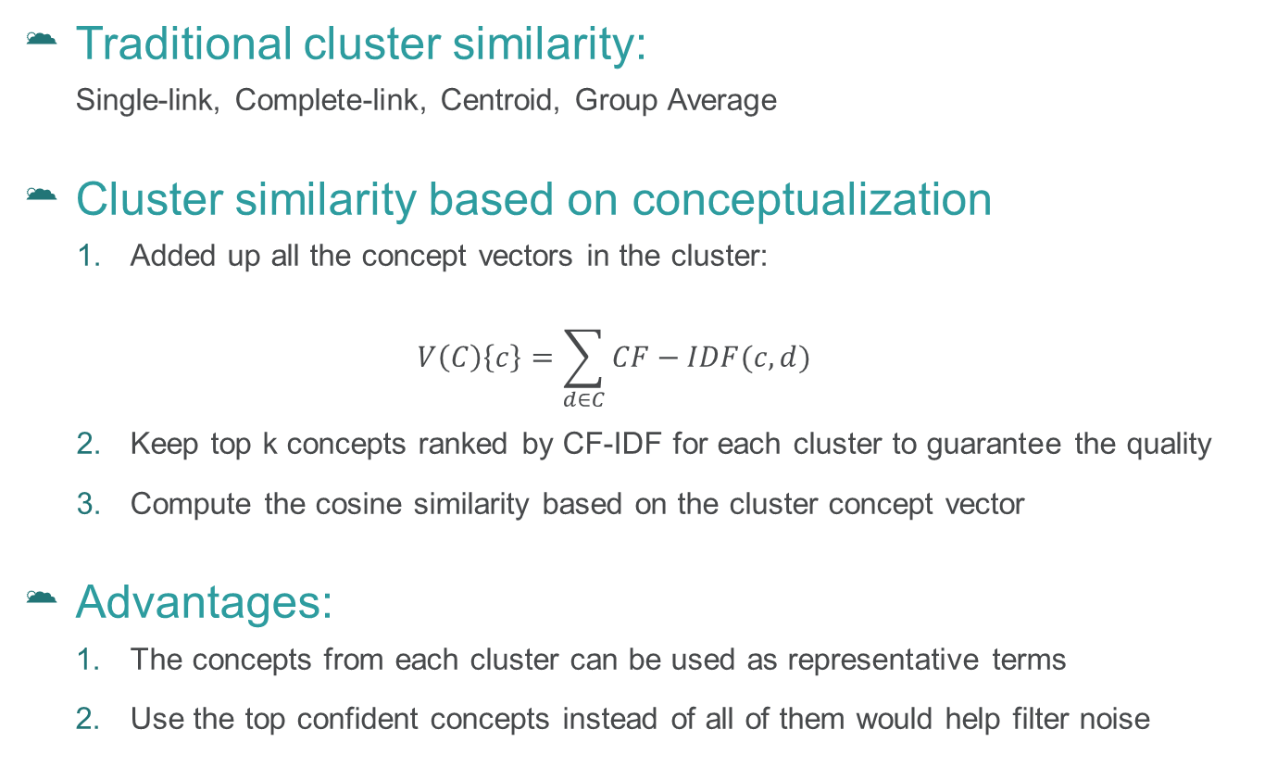
HAC with cluster conceptualization (HAC_CC)
Traditional cluster similarity:
Single-link, Complete-link, Centroid, Group Average
Cluster similarity based on conceptualization
Added up all the concept vectors in the cluster:
$$V\left(C\right)\left\{c\right\}=\sum_{d∈C}{CF−IDF(c,d)}$$
Keep top k concepts ranked by CF-IDF for each cluster to guarantee the quality
Compute the cosine similarity based on the cluster concept vector
Advantages:
The concepts from each cluster can be used as representative terms
Use the top confident concepts instead of all of them would help filter noise

Slide 18
Tri-Stage Clustering (TSC)
Tri-stages:
Stage 1: Clustering on meta context
Stage 2: Clustering on text context
Stage 3: Clustering with concept expansion
Advantages:
Clustering from the most confident signals to less confident signals would help strengthen the confident signals and reduce noise.
Notes:
From 10 min

Slide 19
Tri-Stage Clustering (TSC)
Stage 1: Clustering on meta context
Intuition: Signals from meta data are most related
Method:
Build concept vector for each image from meta context
Clustering using HAC_CC
Stage 2: Clustering on text context
Stage 3: Clustering with concept expansion

Slide 20
Tri-Stage Clustering (TSC)
Stage 1: Clustering on meta context
Stage 2: Clustering on text context
Intuition: Surrounding text also provide signals but less reliable
Method:
Rebuild concept vector for each image on text context
Add up new concept vectors in each cluster to reconstruct cluster vectors
Clustering using HAC_CC
Stage 3: Clustering with concept expansion

Slide 21

Tri-Stage Clustering (TSC)
Stage 1: Clustering on meta context
Stage 2: Clustering on text context
Stage 3: Clustering with concept expansion
Intuition: External knowledge bring more signals
Method:
Replace each concept in a cluster concept vector by the links in the article of the concept
Construct new concept vector for each cluster:
Clustering using HAC_CC
$$V^{′}\left(C\right)\left\{c\right\}=\sum_{c_{i}∈V_{C}}{V\left(C\right)\left\{c_{i}\right\}∗ }CF−IDF(c, d_{c_{i}})$$

Slide 22
A Running Example
Mr. Bean | Rowan Atkinson | Comedy | Blackadder
Clustering with expansion
Mr. Bean | Rowan Atkinson | Comedy | Blackadder
Blackadder | Rowan Atkinson
Expand with Wikipedia
Mr. Bean | Rowan Atkinson | Comedy
Text-context clustering
Mr. Bean | Rowan Atkinson
Rowan Atkinson | Comedy
Blackadder
Expand with text context
Mr. Bean
Meta-context clustering
Mr. Bean
Mr. Bean
Vector with meta-context
Image 1
Image 2
Image 3
Image 4
Notes:
From 11 min, this slide you want to leave more time to explain

Slide 23
Evaluation
Notes:
From 13 min

Slide 24
Data
50 ambiguous queries (10 for tuning threshold and 40 for test)
Top 100 results returned by Google Image Search
barcelona, berry, curve, david walker, diff, george foster, john smith, longhorn, anchester, puma
acrobat, adam, amazon, anderson, andrew appel, apple, arthur morgan, bean, british india, carrier, champion, eclipse, emirates, explorer, focus, friends, jaguar, jerry hobbs, jobs, kiwi, lotus, malibu, morgan, nut, palm, patriot, perfume, pluto, polo, santa fe, shell, sigma, studio one, subway, taurus, tick, tucson, venus, visa, Wilson

Slide 25
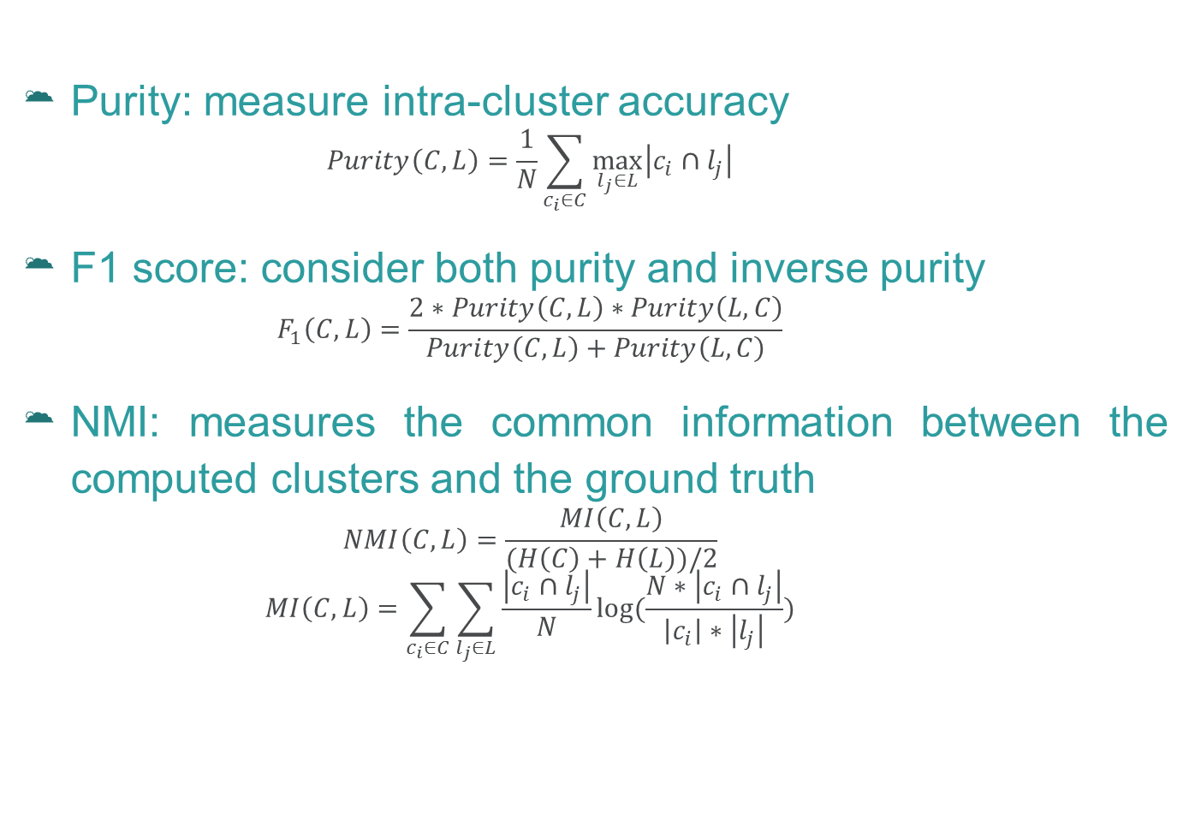
Evaluation Metrics
Purity: measure intra-cluster accuracy
$$Purity\left(C,L\right)=\frac{1}{N}\sum_{c_{i}∈C}{\max_{l_{j}∈L}\left|c_{i}∩l_{j}\right|}$$
F1 score: consider both purity and inverse purity
$$F_{1}\left(C,L\right)=\frac{2∗Purity\left(C,L\right)∗Purity\left(L,C\right)}{Purity\left(C,L\right)+Purity\left(L,C\right)}$$
NMI: measures the common information between the computed clusters and the ground truth
$$NMI\left(C,L\right)=\frac{MI\left(C,L\right)}{(H\left(C\right)+H\left(L\right))/2}$$
$$MI\left(C,L\right)=\sum_{c_{i}∈C}{\sum_{l_{j}∈L}{\frac{\left|c_{i}∩l_{j}\right|}{N}log⁡(\frac{N∗\left|c_{i}∩l_{j}\right|}{\left|c_{i}\right|∗\left|l_{j}\right|})}}$$

Slide 26
Evaluation of Components
Context extraction
Clustering algorithms
Context representation
Context | Purity | F1 | NMI
Whole page | 0.71 | 0.78 | 0.35
Image | 0.91 | 0.80 | 0.59
Image + Query | 0.90 | 0.81 | 0.62
Representation | Purity | F1 | NMI
Bag of words | 0.92 | 0.54 | 0.48
Bag of phrases | 0.94 | 0.62 | 0.50
Concept vector | 0.94 | 0.62 | 0.55
Algorithm | Purity | F1 | NMI | Time (sec.)
AP | 0.92 | 0.55 | 0.50 | 1.9
HAC | 0.94 | 0.62 | 0.55 | 0.9
HAC_CC | 0.94 | 0.76 | 0.59 | 0.7
TSC | 0.90 | 0.81 | 0.62 | 1.1
Notes:
From 14 min

Slide 27
Evaluation against Peers
Peers:
VIPS based (Cai, ICME 2004)
MMCP (Fu, MM 2011)
BOW with HAC
LDA with HAC
 | Cai | MMCP | BOW+HAC | LDA+HAC | TSC
Purity | 0.60 | 0.74 | 0.92 | 0.88 | 0.90
F1 | 0.71 | 0.58 | 0.54 | 0.60 | 0.81
NMI | 0.10 | 0.34 | 0.48 | 0.44 | 0.62

Slide 28
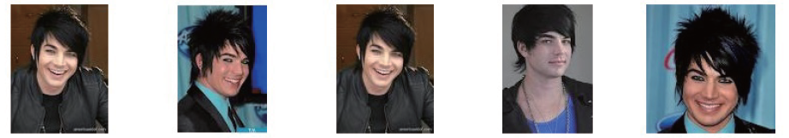
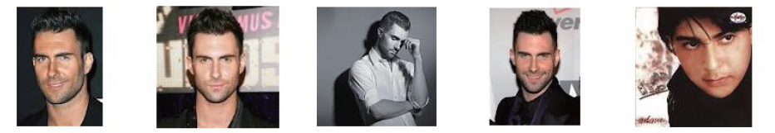
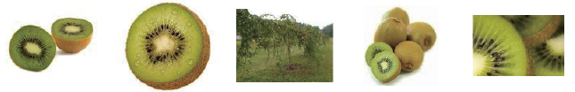
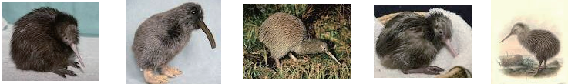
Quality of Conceptualization
Clusters for “adam”
Clusters for “kiwi”
Images | Representative Terms
 | Adam Lambert, American Idol, God, Kris Allen, Privacy policy
 | Adam Levine, Hijab, Mehndi, Fashion, Hairstyle
Images | Representative Terms
 | Kiwifruit, Fruit, Recipe, Health benefit, New Zealand
 | Kiwi, Bird, New Zealand, Egg, Smithsonian National Zoological Park

Slide 29
Thank you for your attention!
Notes:
End with 16 - 17 min

